Slide 1
ASTRONOMY BASED WEBSITE (BITSPACE)
Team members:
SANJANA MISHRA (18BCE2324)
ANURAG PARCHA (18BCE2335)
SNEHA PREM KIRON (18BCI0249)
CSE3002
Internet and Web Programming
Review III

Slide 2

Introduction & Abstract
The notion of Space and the Cosmos and its entirety has always existed in the minds for humanity in some form or another from thousands of years. Back when Ptolemy proposed that the Earth was the centre of the Universe. And this was the widely accepted theory, until Copernicus came by and said that the Sun is the centre. But was humiliated and mocked.
Galileo Galilei was almost executed for proposing the Helio-centric theory because of his invention of the working telescope. We can see a pattern in almost all the cases in the past and the present where revolutionary ideologies are suppressed due to a lack of knowledge by the suppressors.
In this day and time, it still happens. Now, it is time to change that, especially since by the day, Space travel and settlement edges ever so slightly to humanity’s accessibility. Soon, in the future, it will be everybody’s necessity to know about our beautiful Universe and beyond not as a scholar, but as a human.
Hence, the necessity for as many resources as possible for people to learn about our Cosmic Environment, may it be from amateur astronomy or learning deep concepts about space. This is provided by BITSPACE.

Slide 3

Summary of the project -Abstract
We have built an astronomy related website which provides many services which helps educate people on astronomy as well as other space related topics, it will help amateur astronomers overcome their fears of entering into the field of Stargazing and Astro-photography, it will also help experienced astronomers to find out real time news and data feeds about space and related topics. Users will be most active on the forum pages where many questions can be asked, topics can be discussed, and many more, ALL in one place. The Website is secure with user validation, accessible, highly efficient and also search engine optimized.
The Project entailed 2 phases of web development:
Front-end: HTML5, CSS3, JavaScript, Handlebars to meet the above mentioned needs.
Back-end: Node.js , MongoDB (Database)
Git and GitHub for Project Efficiency and Consistency.

Slide 4

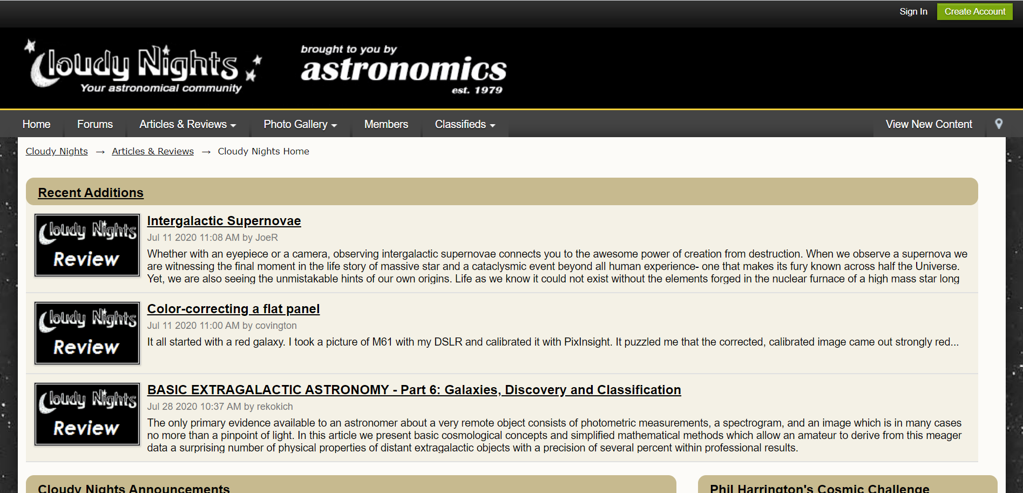
Compare your work V/s existing work
There exists a website called CLOUDY NIGHTS
Cloudy Nights is a forum which also features articles and reviews.

Slide 5
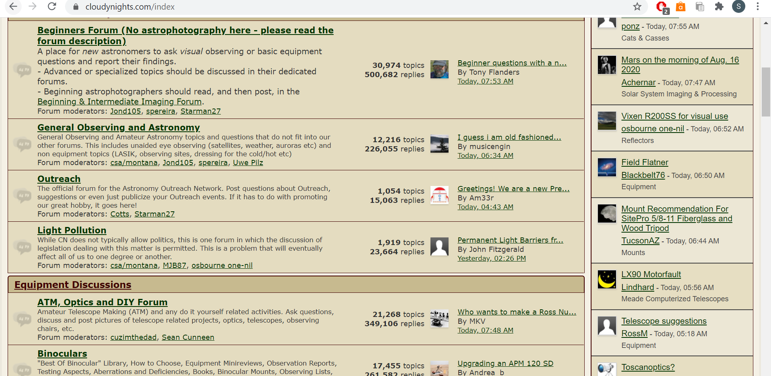
Further, our website will have a fairly modern and clean feel to it that will provide for a pleasant user experience (as the Cloudy Nights website seems monotone and slightly of putting with the tan shade overall.)

Slide 6
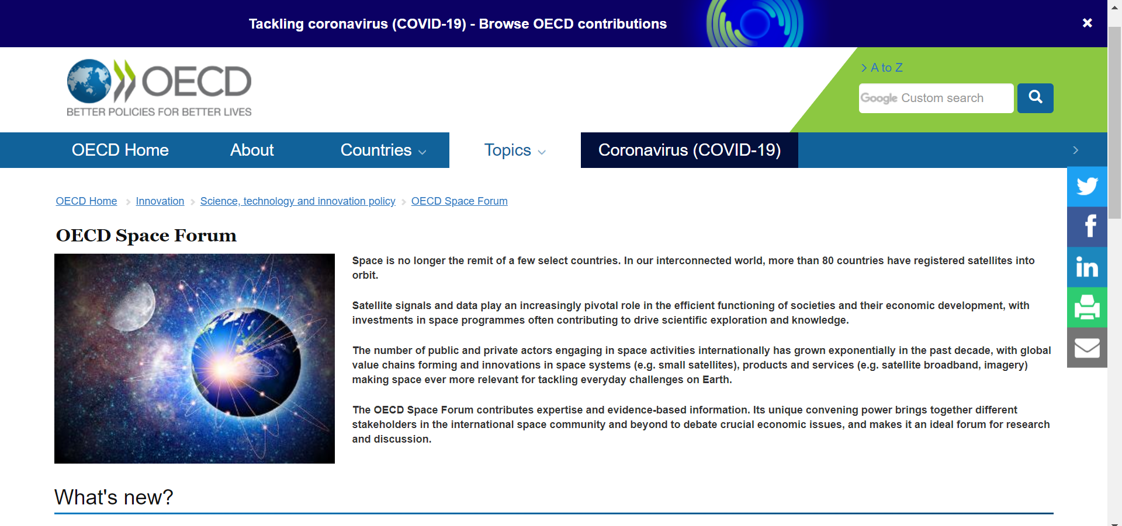
There also exists a platform called OECD Space Forum

Slide 7
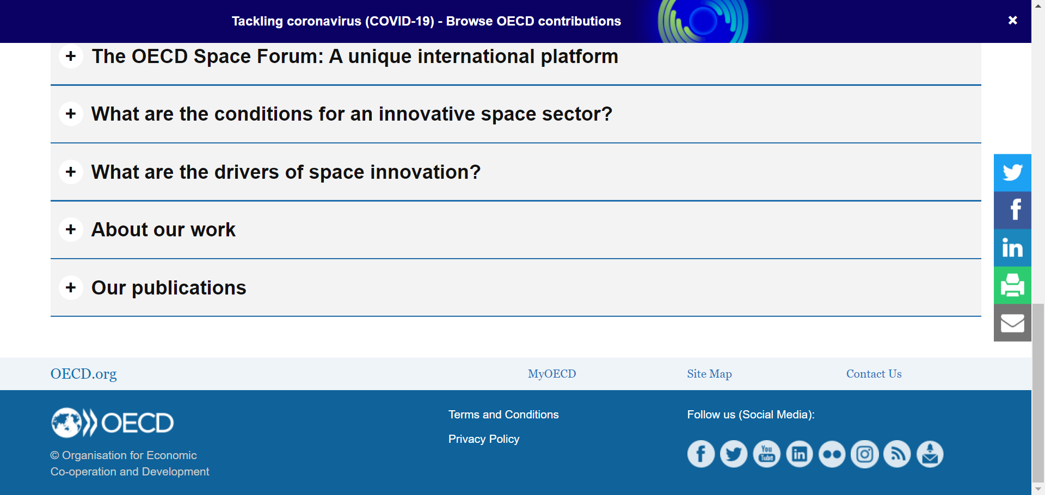
Again, OECD provides news, articles and publications; very similar to Cloudy Nights.
The addition of inclusion of links to buying trusted astronomical equipment products such as telescopes, is what sets us apart from OECD.

Slide 8
When compared to existing work, our work is seen to be more modern; and incorporates many other aspects than just a forums or articles. We hoped to provide a user experience that entails dynamism and is not just static.

Slide 9

Challenges & Issues of Existing System
Current system are fairly very plain in view; they also use older tools for development.
Current systems do not all include every feature of forums, news, store and gallery all in one place. They are dedicated to only one or two of the aforementioned features.

Slide 10

Motivation
With the growing interest of many people in Astronomy and space research, we have observed that not many platforms exist that cater to these specific needs.
We also noticed that there are few to none websites which have heavily space and astronomy oriented forum websites with actual interactive UI s and a “space” to showcase Astro-Photography.
As Astronomy and Stargazing is heavily based on region, we have observed there are few to none websites which exist that help amateur or experienced astronomers and people in general who are interested in Astronomy in India.
We have designed a website to do exactly the same.
Current system focused only on either an exclusive forums based website with an old or plain GUI with only forums and news components; and it fails to take into account user experience or provision of a store ,hence forth this work aims to develop to solve this issues by providing a platform with Forums, News, Gallery and Store components whilst making sure that the user isn’t just looking at a static page and thus taking into account visual appeal and user experience.

Slide 11

Objectives
The website is mostly a forum-based style, where users will be able to post their questions and similarly give answers to other people with questions about astronomy and any space related topics.
The Website will also contain a News facility to provide the users with updated news and information related to astronomy and space. News from ISRO/NASA/ROSCOSMOS and many other space agencies will also be available.
The Website includes a login and signup service and make users unique to their website IDs which allows them to fully use Forums.
We are also going to include pages for producers and retailers of astronomical equipment/technologies and games to promote their products.
The Website contains a Photo-gallery page where users can view breath-taking images of Space and space related sights.

Slide 12
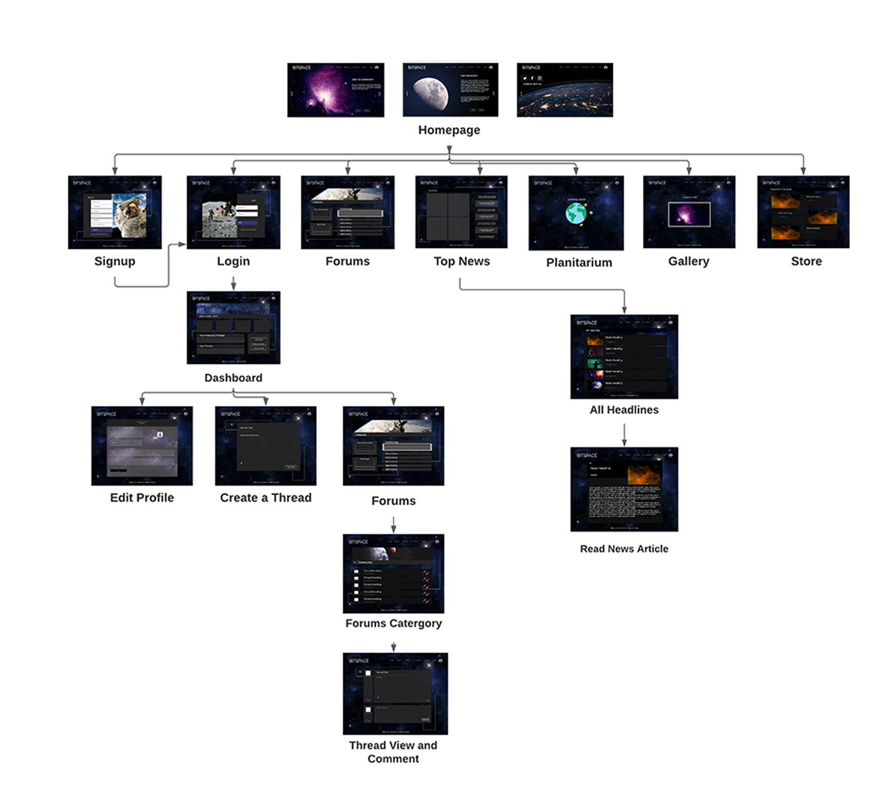
Architectural Diagram

Slide 13
Client & End users of the system
The following are the clients or users of our system:
Space enthusiasts.
Astronomers.
Anyone interested in viewing or buying Astronomical Equipment.
Any individual keen on discussion of space-related technology or topics.
Retailers of Astronomical Equipment/ Technologies/ Softwares or Games.

Slide 14
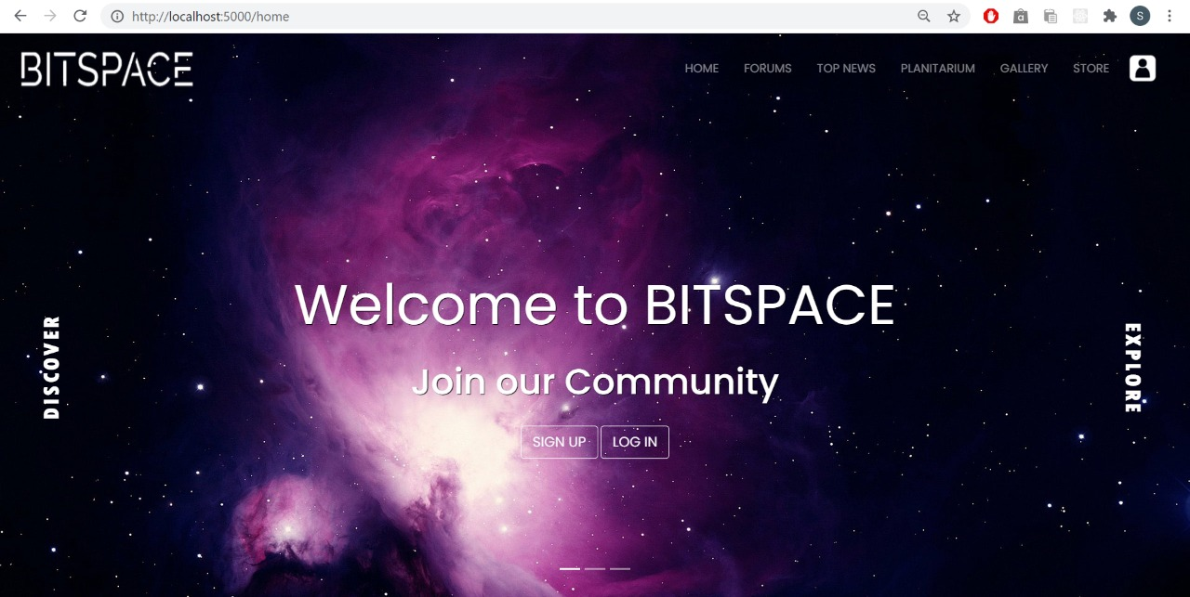
Detailed Description
Module: Home
This is the landing page, it is the first page the user is directed to upon arrival on the website

Slide 15
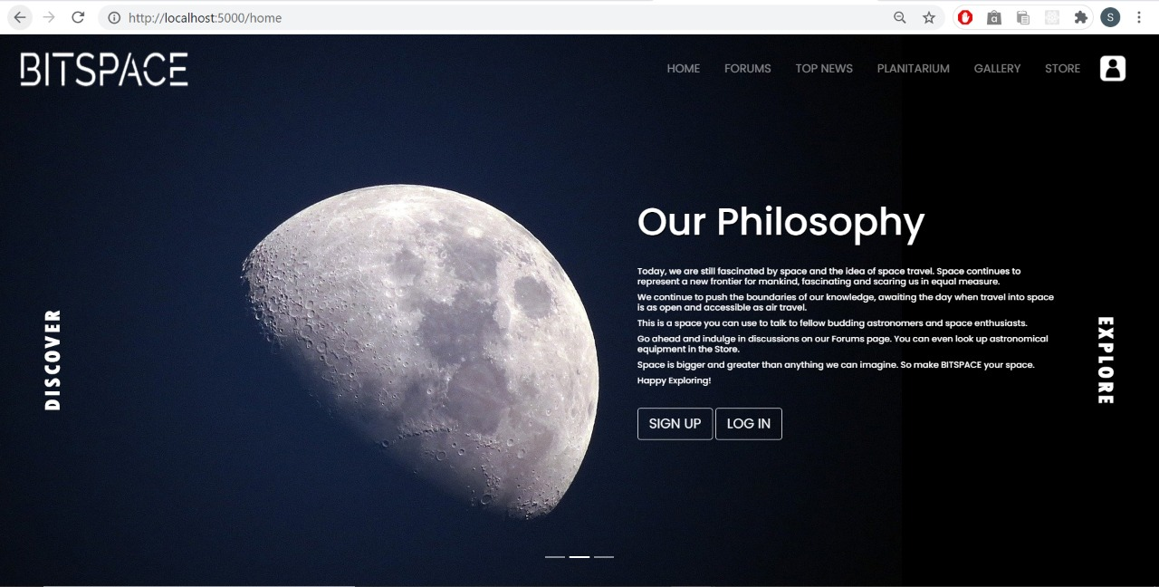
Detailed Description
Module: Home
This is the landing page, it is the first page the user is directed to upon arrival on the website

Slide 16
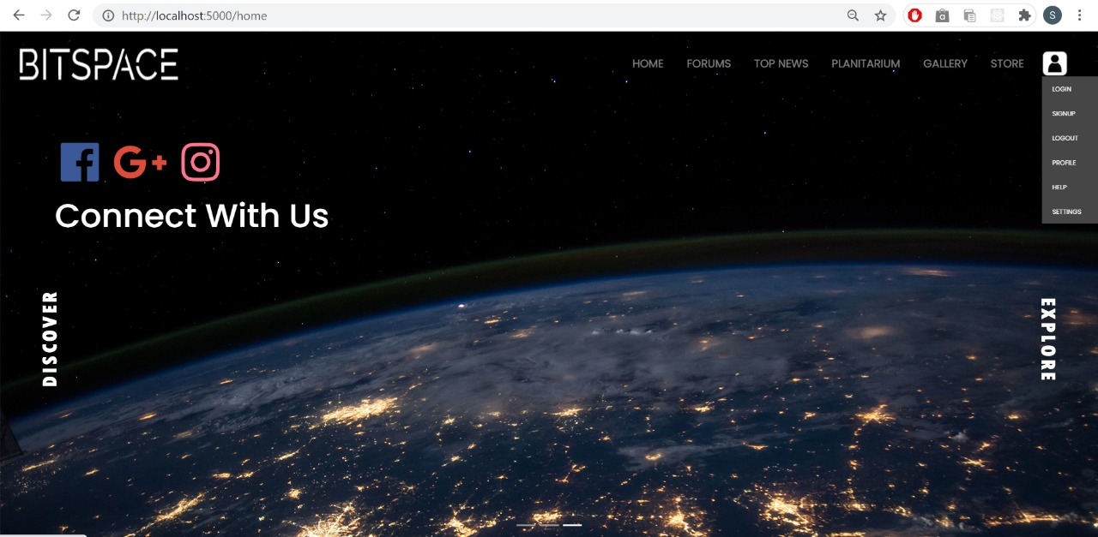
Detailed Description
Module: Home
This is the landing page, it is the first page the user is directed to upon arrival on the website

Slide 17
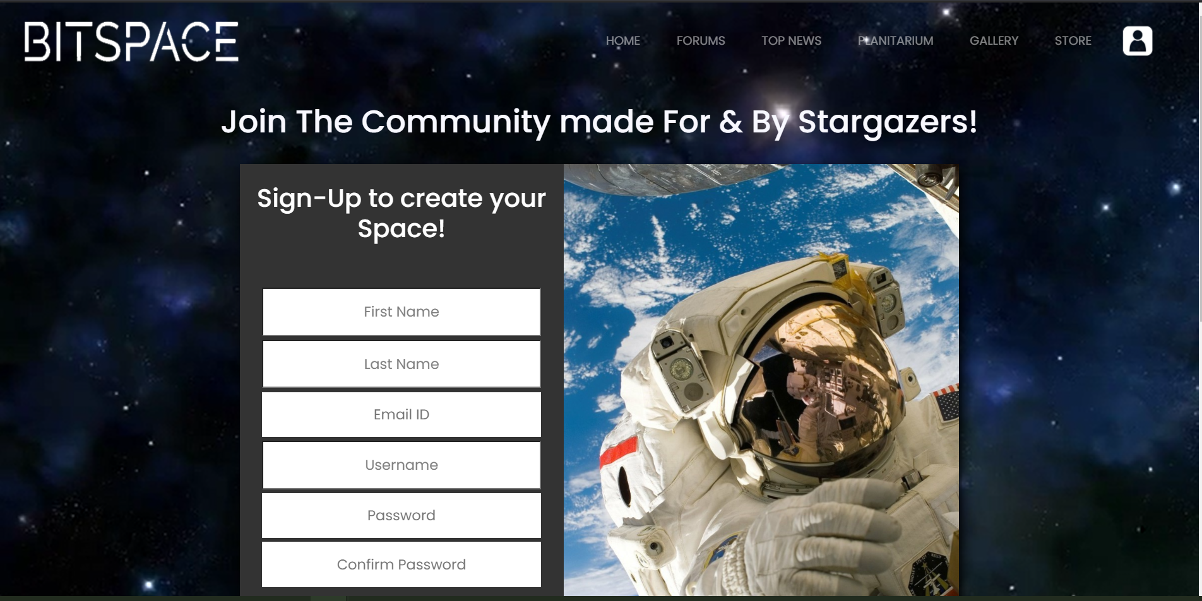
Detailed Description
Module: Signup
New users must sign up first to be able to fully use the forums pages; includes complete validation

Slide 18
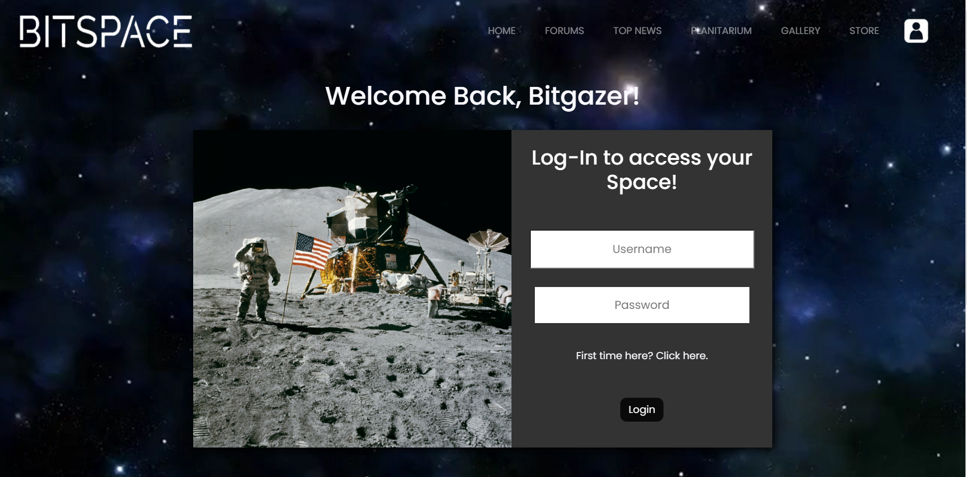
Detailed Description
Module: Login
For existing user, they must login to access forums page; this involves complete validation

Slide 19
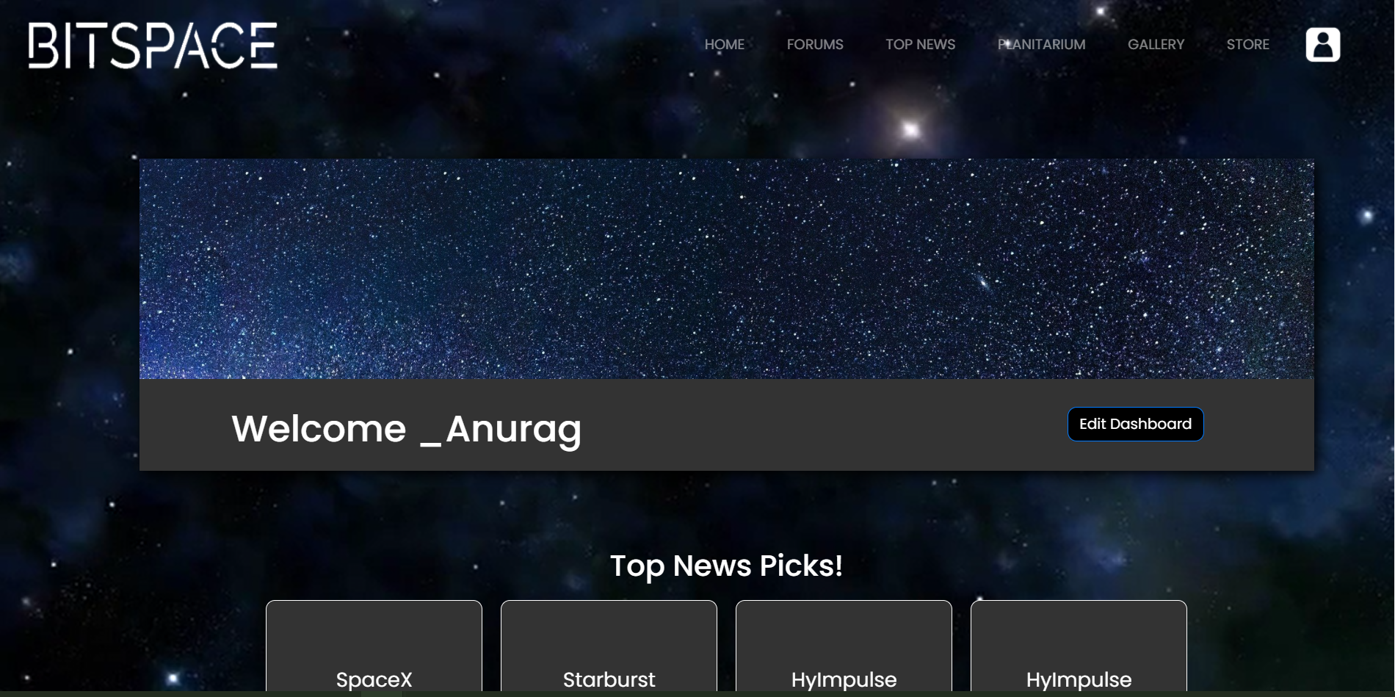
Detailed Description
Module: Dashboard
Once logged in, the user will first be directed to Dashboard, which is a FULLY PERSONALIZED page for every user which contains username, their liked thread, their threads, also can navigate to editing profile; forums page; etc.

Slide 20
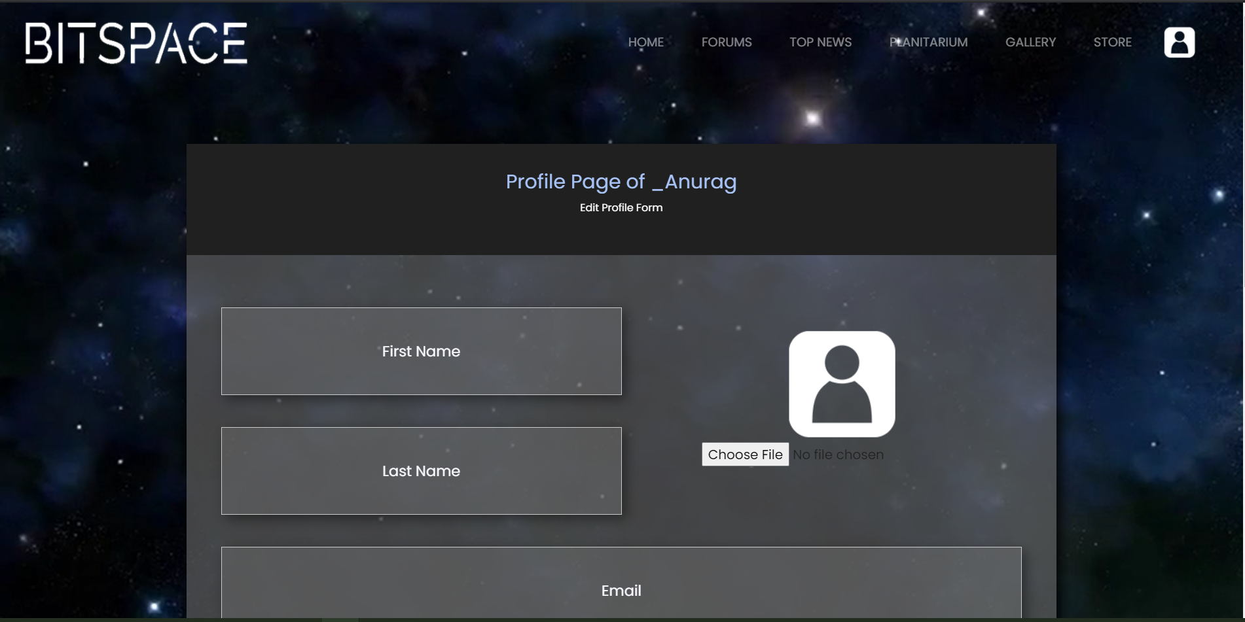
Detailed Description
Module: Edit Profile
Allows user to update credentials

Slide 21
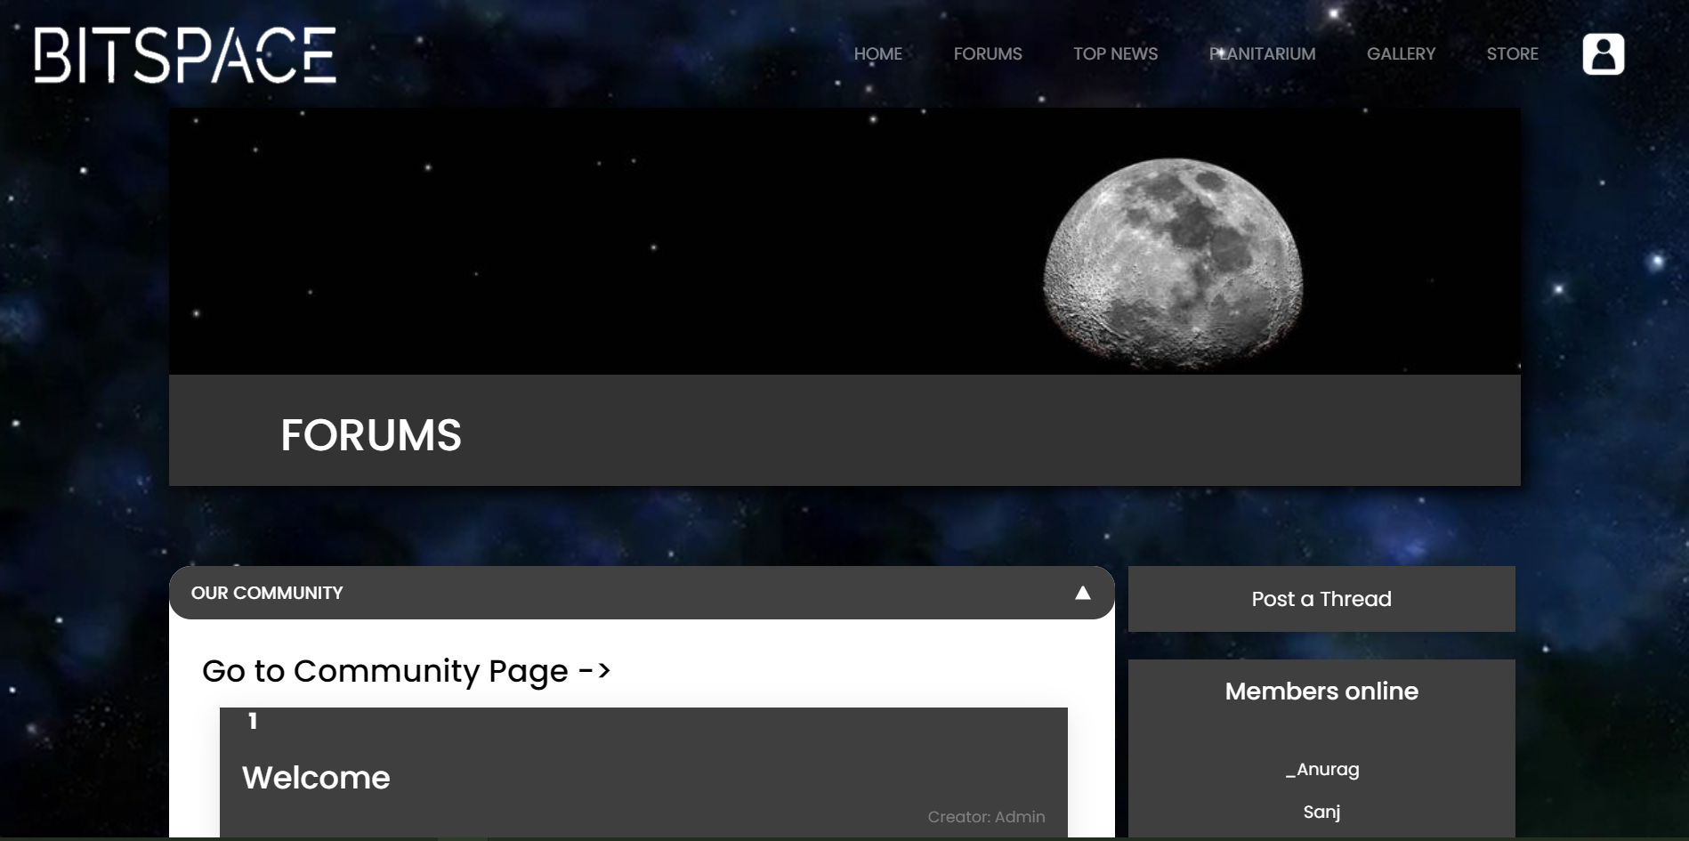
Detailed Description
Module: Forums- homepage
Main Forums page; includes main list of categories; allows user to route to a page containing full list of threads in a particular category; also allows user to write a thread

Slide 22
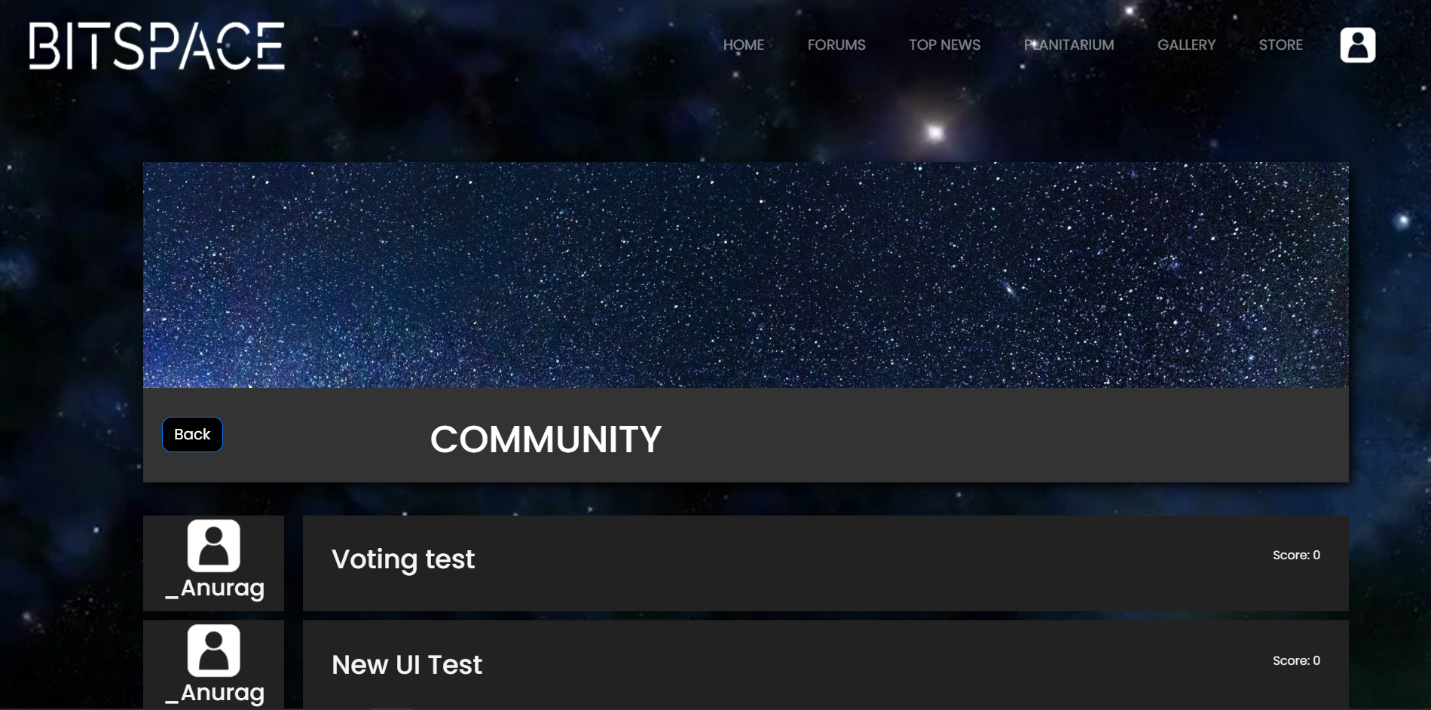
Detailed Description
Module: Forum Category-wise list
Renders the list of all threads in a particular category

Slide 23
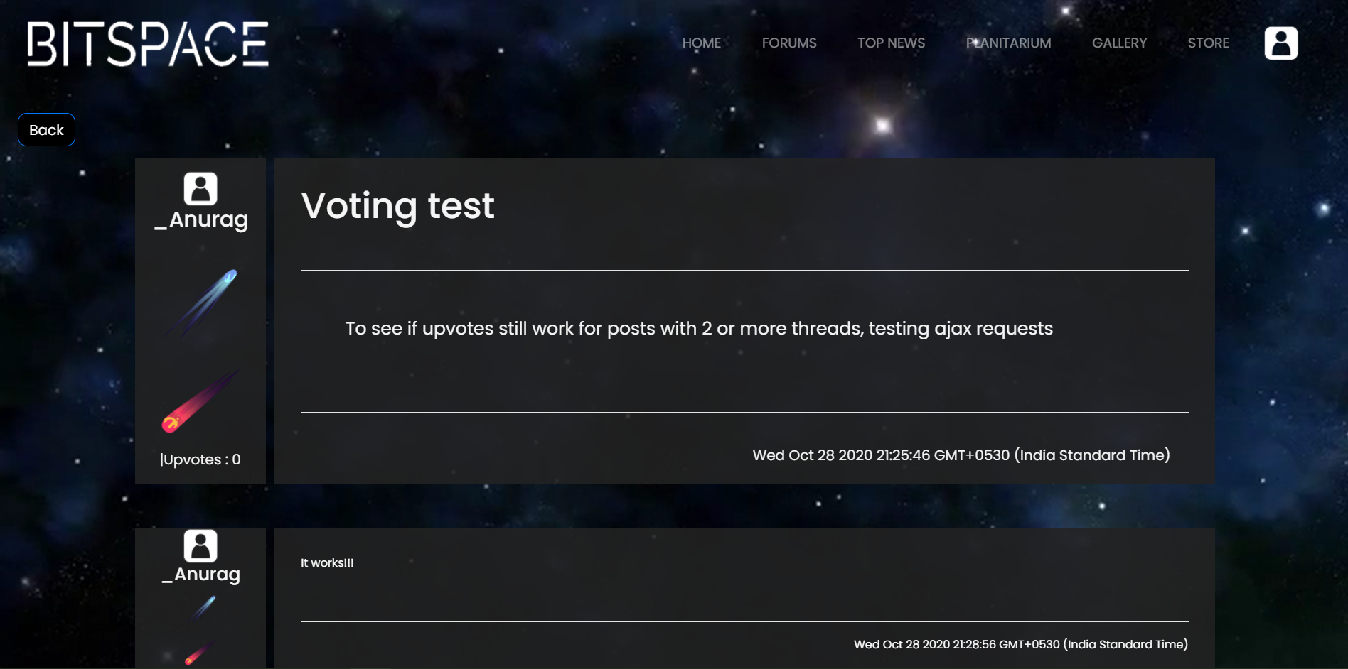
Detailed Description
Module: Reading a thread
Users can read a thread and see comments that follow; also comment on the thread themselves and upvote or downvote a thread.

Slide 24
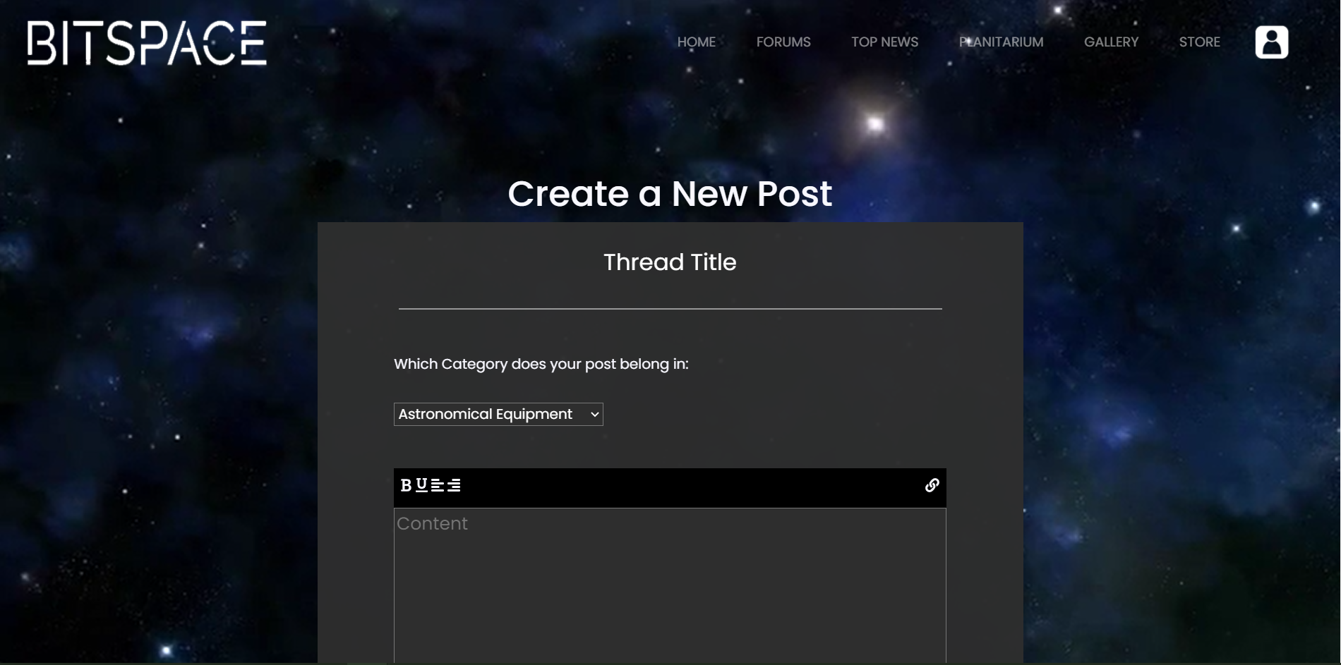
Detailed Description
Module: Create a thread/post
Allows user to create a new post

Slide 25
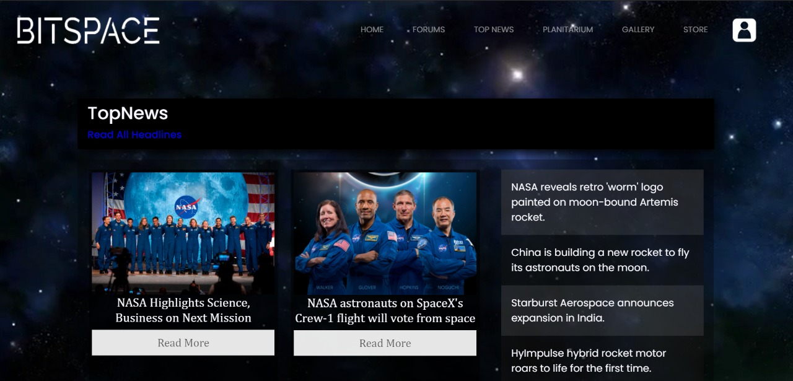
Detailed Description
Module: Top News
This page contains the main news headlines with modals for full article

Slide 26
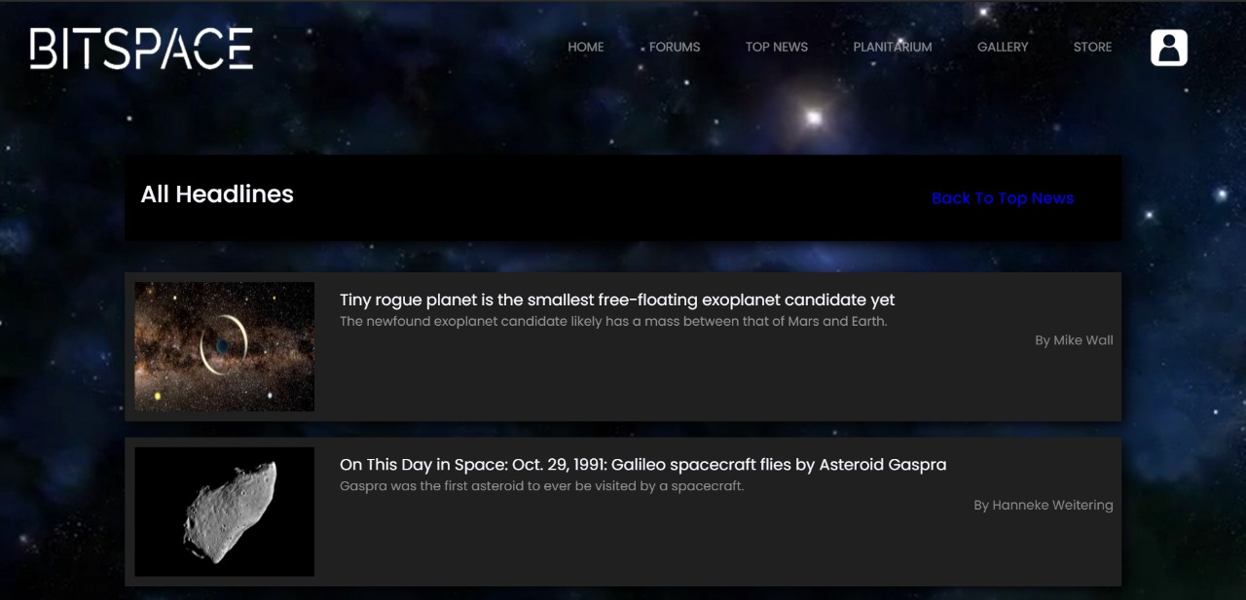
Detailed Description
Module: Top News Headlines
This page contains the list of headlines

Slide 27
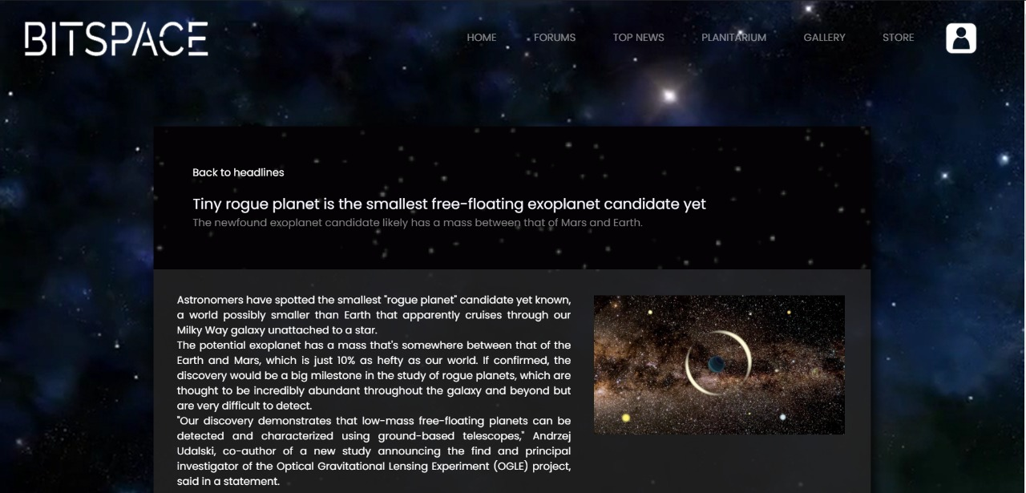
Detailed Description
Module: Read News Article
This page contains full article

Slide 28
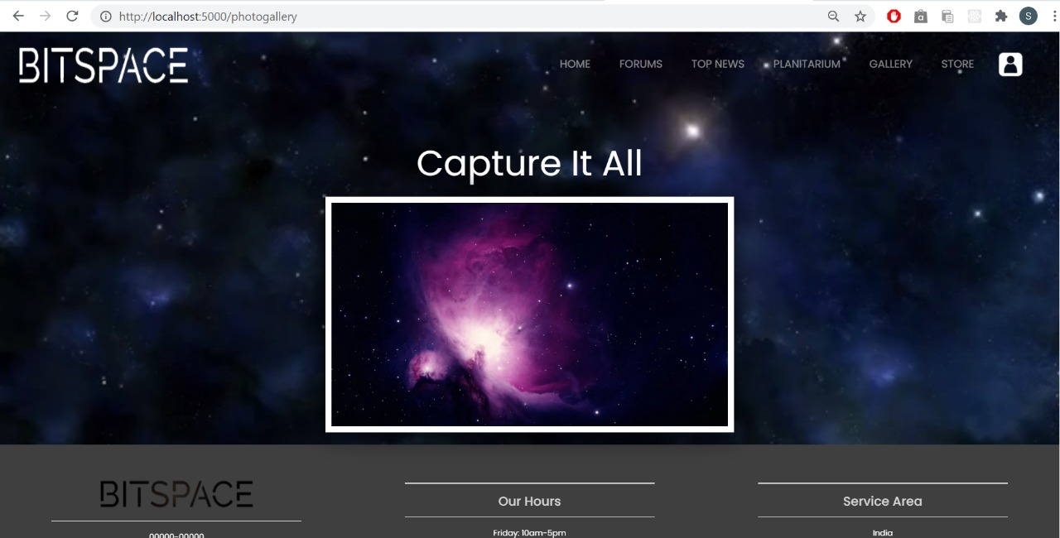
Detailed Description
Module: Gallery
This page contains slideshow of images

Slide 29
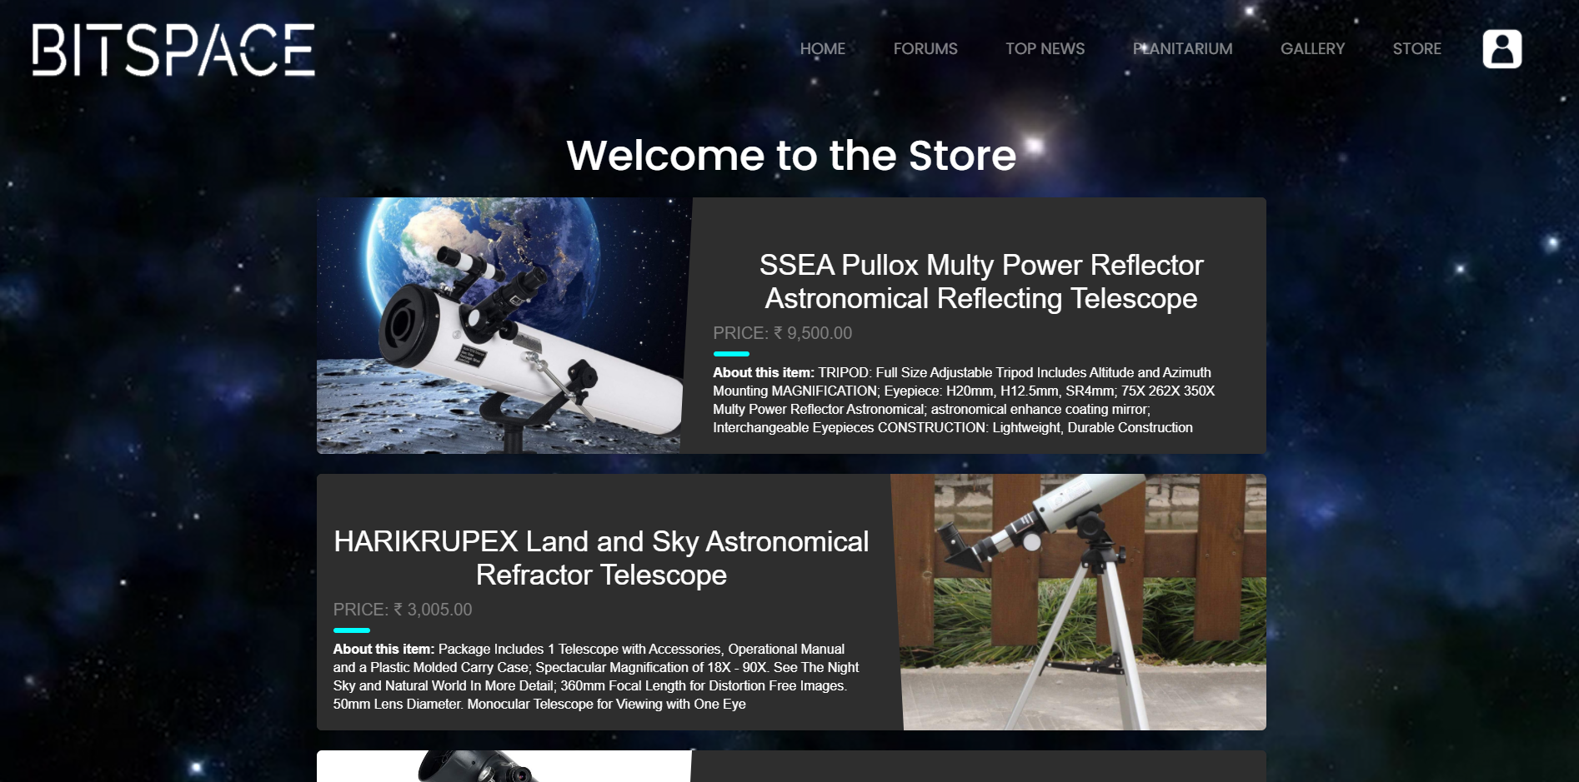
Detailed Description
Module: Store
This page contains list of top astronomical equipment picked by us; links to Amazon to purchase

Slide 30

Test report
Name | Rating (1-5)
Indrani Mishra | 5
Sanjit Mishra | 4
Madhav Parcha | 4
Srilatha Parcha | 5
Suhaas Parcha | 5
Prem Kiron | 5
Seema Kiron | 5

Slide 31
Highlights of work
One stop destination for major space related entities: Forums, News page, Store, Gallery; with complete user authentication and authorization.
Currently a free website.
Appealing GUI with dynamism.

Slide 32
Conclusion
We have built a website that takes into account major aspects that come to mind when one thinks of things related space.
We have used booming and newer tools such as MongoDB and Node.js with Express Framework and handlebars which are of great importance in todays web development scenario.
Through this project implementation, we have been introduced to the world of web development and have learned how to use many of the newer tools and techniques.

Slide 33
Future Developments
We plan on implementing a built-in service in the website to gather the user's GPS information and give accurate weather data and star chart data based on their location in the country or the planet
A provision for our users to get in contact with an exclusive Dealers.
Allow for users to send in their stargazing images which we will incorporate into the Gallery as a feed.
Complete deployment of the website on real-time server to make it available to all.

Slide 34
References
https://www.cloudynights.com/index
https://space.com/
http://www.oecd.org/innovation/inno/space-forum/
https://www.websitebuilderexpert.com/building-websites/
https://www.w3schools.com/html/

